Slide 1

Research Title: Building an ML-based Ensemble Model for Fraud Detection in Digital Banking Transactions
MSc Computing Research Project
Student:
Supervisor: [Supervisor Name]
University: Sheffield Hallam University

Slide 2
Acknowledgements
    I would like to thank my supervisor for the guidance, feedback and academic support provided throughout this project.
    I also acknowledge Sheffield Hallam University for providing the academic resources and learning environment required to complete the research.
AI Declaration
    AI tools were used to support the preparation of this presentation, including language refinement and proofreading, while the research, analysis, implementation, results, and conclusions were independently developed by the student
Notes:
1.7.2013
‹#›

Slide 3
Agenda
    Introduction
    Literature Review
    Methodology
    Ethics
    Implementation
    Results
    Evaluation
    Conclusion
    References
    AI Declaration
Notes:
1.7.2013
‹#›

Slide 4
Research Aim and objectives
Introduction
Digital banking has been responsible for growing transaction volumes, but it's also made bank fraud more complex. Traditional rule-based and single model techniques can fall short when it comes to non-linear and evolving fraud patterns, and false positives can lead to customer friction (Manzoor & Aslam, 2025; Naeem, Butt & Javeid, 2026) .
Research Aim
    To develop, assess, and implement a machine learning-based ensemble model that maximises fraud-detection precision and minimises false positives across high-velocity, diverse transactions in digital banking.
    Research Objectives
    To thoroughly analyse and pre-process high-velocity transaction datasets in digital banking for addressing challenges such as missing data and severe class imbalance.
    To design a machine learning-based ensemble framework by combining diverse base learners for improving predictive performance.
    To optimise the parameters of the model and dynamic stacking mechanisms for balancing high precision of fraud detection with low rates of false positives.
    To assess and validate the performance of the ensemble model against the individual baseline algorithms by using metrics such as the F1 score, AUC-ROC, and computational latency.
Notes:
Digital banking has experienced exponential transaction growth, but the rapid expansion has made fraud patterns much more complicated and adaptive. Conventional rule-based systems and standalone machine learning models are struggling to detect non-linear fraud behaviours and have often generated high false positive rates, which degrades the experience of customers.
In order to address these challenges, the main aim of the research is to assess, develop, and implement a machine learning-based ensemble model that can maximise precision of fraud detection while minimising false positives throughout high-velocity digital banking transactions.
In order to achieve this overarching aim, four specific research objectives were established. Firstly, to preprocess transaction datasets and tackle severe class imbalance by using techniques such as SMOTE without causing data leakage. Secondly, to design a dynamic stacking ensemble framework which combines diverse base classifiers, particularly XGBoost and Random Forest, with a logistic regression meta-classifier. Thirdly, to optimise parameters and decision thresholds for balancing precision and rates of false positives. Finally, to assess the ensemble against baseline models throughout main performance metrics which include F1-score, AUC-ROC, and computational latency.

Slide 5

Literature Review
The literature reveals that: As the literature indicates:
    Class imbalance, false positives, model selection and computational efficiency were identified as key issues in digital banking fraud detection, according to research.
    SMOTE and feature engineering have been extensively explored solutions for dealing with imbalanced data, with ensemble methods harnessing the strengths of multiple classifiers(George et al., 2025; Guterres et al., 2026; Rajasekar et al., 2026). Deep-learning methods can achieve good predictive performance; however, at significantly higher computational costs.
    Research Gap
    Some important balance between recalling fraud and reducing the false-positive rate, computational efficiency and robustness to changes in data conditions is still difficult to achieve in the existing research.
Notes:
Moving to the literature review, the analysis has highlighted four recurring core challenges in digital banking fraud detection, which are severe class imbalance, high false positive rates, complexities in model selection, and operational computational efficiency. In order to address extreme class imbalance, techniques such as SMOTE oversampling and curated feature engineering are supported widely in the current research. In addition to this, ensemble methods are raised frequently for making use of complementary strengths of multiple classifiers for capturing complicated fraud patterns. While methods of deep learning can achieve strong predictive performance, literature can demonstrate that they do so at significantly higher costs of computation, and this makes them challenging for real-time applications.
The discussion to the key research issues identified throughout existing studies. Achieving a practical balance between maximising fraud recall, maintaining ultra-low computational latency, minimising rates of false positives, and ensuring strength against changing data distributions have remained a major challenge. The research has directly addressed this gap by quantitatively assessing if a stacked ensemble can offer balanced improvement over optimised standalone models.

Slide 6
Methodology
The approach undertaken in the project was a quantitative and computational approach that was based on secondary data.
Dataset
The Bank Account Fraud Dataset for NeurIPS 2022.
    Nearly 1 million anonymised records
    30 features
    Severe class imbalance
    Process
    Data, pre-processing, 70/30 Stratified Split, SMOTE, Model Training, Ensemble, Evaluation
    To prevent data leakage, SMOTE was only used on the train set.
    Evaluation
    Precision, Recall, F1-score, AUC-ROC, False Positive Rate and computational latency were used to assess performance.
Notes:
Moving on to the research methodology, this study conducted and applied computational and quantitative framework which depends on secondary data. For this particular dataset, the project has made use of the Public Bank Account Fraud dataset from NeurIPS 2022, accessed via Kaggle. It comprised nearly 1 million records throughout 30 features and exhibited severe class imbalance, and it mirrored real-world operational challenges of digital banking fraud.
The experimental process followed a structured pipeline of machine learning. After cleaning and preprocessing, the data was partitioned by using a 70/30 stratified split to preserve class proportions. More importantly, in order to strictly avoid performance inflation and data leakage, SMOTE resampling was implemented exclusively to the training set. Following oversampling, baseline models and the stacked ensemble were trained and validated. Finally, assessment of the model was conducted comprehensively throughout multiple metrics of Precision, Recall, F1-score, AUC-ROC, False Positive Rate, and computational latency, and this ensured that both real-time efficiency and predictive quality were measured.

Slide 7
Ethics
    This project relied on a secondary dataset (pre-anonymised) that was made available to the public, and no primary data was collected or did human subjects participate.
    There was no personally identifiable information used, so there were no participant-related risks such as informed consent, privacy or participant identification. The information was kept in a secure way on storage that was password-protected.
    Ethics position: UREC2 Low Risk Human Participant Research Ethics documentation completed (no external or NHS approval required).
Notes:
Addressing the ethical considerations, this project has depended early on publicly available and pre-anonymised secondary dataset, which means that no primary data collection was carried out and no human participants were involved. Since no personally identifiable information was processed, typical risks related to participants, such as privacy breaches, informed consent, or individual identification, were fully mitigated. In addition to this, data security and integrity were maintained strictly by storing all the files on password-protected digital storage which are accessible only to the primary researcher. In terms of formal ethics approval, the study met the criteria for the UREC2 Low Risk Human Participant Research Ethics framework. As a result, no external or NHS Ethics Committee approval was needed for executing the research.

Slide 8
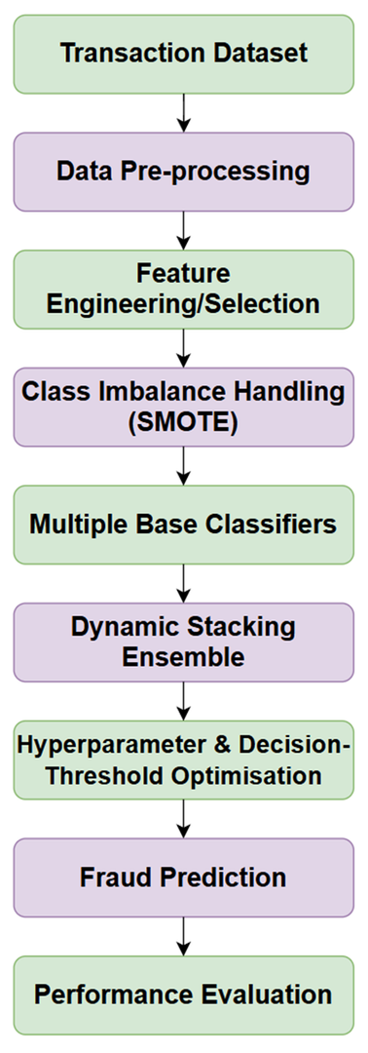
Project Design / Implementation
The design was developed to address class imbalance, fraud detection, false-positive control and computational latency.
Notes:
With regards to the project design and implementation, the technical system was engineered for specifically addressing class imbalance, high fraud detection accuracy, low computational latency, and false positive reduction. The framework has followed a sequential end-to-end processing pipeline which is implemented entirely in Python by using scikit-learn and pandas. The workflow begins with preprocessing and data ingestion, where categorical features were encoded and the missing values were resolved. In order to address the severe class distribution skew without introducing data leakage into the test set, SMOTE oversampling was implemented exclusively to the training split.
After data preparation, multiple base classifiers, particularly XGBoost and Random Forest, were trained on the balanced data. Predictions generated by such base models were fed into a dynamic stacking ensemble which may not use a logistic regression meta-classifier. Decision thresholds and hyperparameters were fine-tuned systematically for balancing precision against false positive rates before generating final fraud classifications. The complete architecture automated the full machine learning procedure, bridging raw data preprocessing, performance evaluation, and ensemble modelling within a unified computational flow.

Slide 9
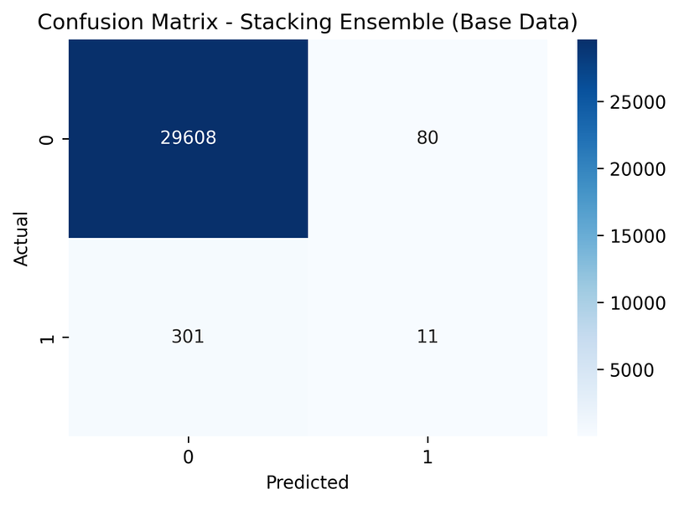
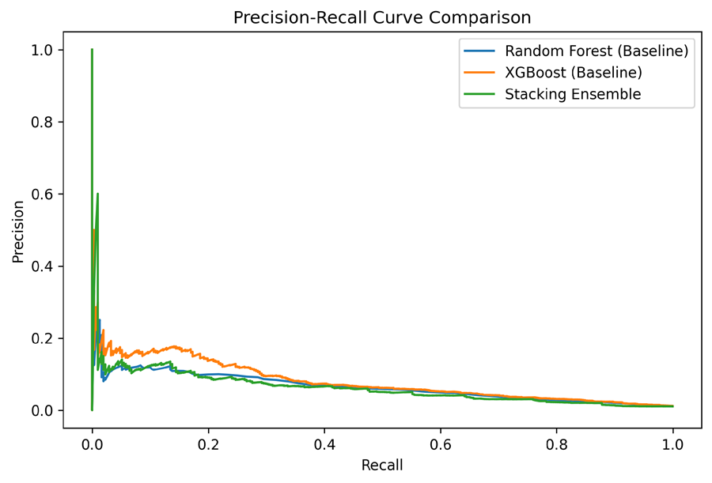
Prototype
As a result of this, the Fraud Detection Model was implemented.
    The prototype was written in Python with the help of pandas and scikit-learn.
    The model combines:
    Random Forest
    Baseline classifier
    XGBoost
    Baseline gradient-boosting classifier
    Stacking Ensemble
    The second model is a Random Forest + XGBoost meta-classifier with logistic regression.
    The entire process of preprocessing, SMOTE, model training, prediction and model performance evaluation were performed.
Stacking Ensemble Confusion Matrix.
Precision–Recall Trade-off for the Evaluated Models.
Notes:
Focusing on the development of prototype, the functional fraud detection pipeline was implemented successfully in Python by using scikit-learn and pandas. The technical implementation incorporated two baseline models of a Random Forest classifier and an XGBoost gradient-boosting classifier. These baseline algorithms were trained individually for establishing core performance benchmarks. In addition to this, a stacking ensemble architecture was also constructed which combined the probability predictions of XGBoost and Random Forest by using a Logistic Regression meta-classifier.
The execution of prototype covered the full machine learning life cycle, which automated preprocessing, SMOTE oversampling, prediction generation, model training, and performance assessment. As shown by the confusion matrix and precision-recall curve artefacts, the prototype captured the precision-recall trade-offs and error distributions effectively across the evaluated models.

Slide 10
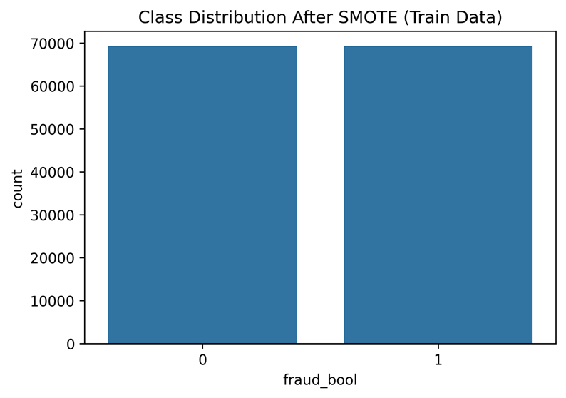
Results & Evaluation
Base Dataset
Key finding: XGBoost outperformed the Stacking Ensemble on the Base dataset, and trained significantly quicker.
Robustness
The Stacking Ensemble performed well on at least five variant datasets, achieving the best score of 0.1250 on Variant II.
Model | F1 | AUC-ROC | FPR | Training
Random Forest | 0.0451 | 0.8271 | 0.0026 | 39.94s
XGBoost | 0.0576 | 0.8441 | 0.0020 | 3.05s
Stacking | 0.0546 | 0.7838 | 0.0027 | 118.86s
Class Distribution After SMOTE.
Notes:
Examining the results, an assessment on the base dataset an important finding emerged. XGBoost outperformed the stacking ensemble through predictive metrics while training significantly faster. Particularly, XGBoost achieved the highest performance with an F1 score of 0.0576, an AUC-ROC of 0.8441, and a low false positive rate of 0.0020, and it took only 3.05 seconds to train. In comparison, the stacking ensemble yielded an F1 score of 0.0546, an AUC-ROC of 0.7838, and an FPR of 0.0027, and it required a training time of 118.86 seconds. Random Forest recorded an F1 score of 0.0451 and an AUC-ROC of 0.8271. Such methods have demonstrated that adding ensemble complexity cannot automatically guarantee superior performance over a strong standalone model.
With regards to robustness, the stacking ensemble retained measurable generalisation throughout five variant datasets under distributional and temporal shifts as it reached its peak F1 score of 0.1250 on Variant II. In addition to this, applying SMOTE to the training set successfully balanced the class distribution to roughly 70,000 records per class, thereby addressing the initial severe class imbalance without leaking the data into assessment splits.

Slide 11
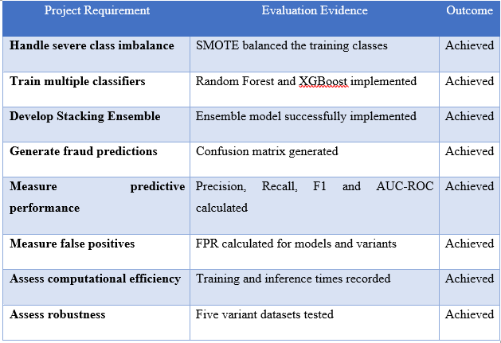
Evaluation
System Evaluation
    Eight system tests were performed; these included:
    Data loading, Pre-processing, SMOTE, Model Training, Ensemble Prediction, Performance Evaluation, False-Positive Testing, Computational Testing.
    There was a Passed grade for all 8 tests.
    Overall Evaluation
    The core technical requirements were met, such as class-imbalance treatment, model development, fraud prediction, model performance metrics, false-positive analysis, computational assessment and robustness testing.
    Limitations:
    The project was based on secondary, pre-anonymised data with no potential beneficiaries/human users participating. As such, evidence of user feedback and consent did not exist.
Evaluation against Project Requirements.
Notes:
For the system evaluation, eight formal acceptance tests were executed throughout the entire technical pipeline, which includes preprocessing, data load, model training, SMOTE handling, metric evaluation, false positive testing, and computational assessment. All eight system tests achieved a pass status, which confirmed end-to-end functional reliability. In the overall project evaluation, the core technical requirements were met successfully. These included resolving severe class imbalance, constructing a stacked ensemble, evaluating predictive metrics, implementing multiple base classifiers, measuring latency, analysing false-positive rates, and conducting variant robustness testing.
An important limitation of the evaluation stemmed from the usage of pre-anonymised and secondary data without direct participation of human subjects. As a result, stakeholder validation, qualitative user feedback, and consent documentation were not applicable. System acceptance was thereby validated strictly through quantitative metrics evaluation against requirements and objective test cases.

Slide 12
Conclusion
    The project was successful in building and testing a pipeline for fraud detection with machine learning techniques SMOTE, Random Forest, XGBoost and a Stacking Ensemble.
    The results indicated that the XGBoost had the greatest Base-dataset performance and the Stacking Ensemble had measurable robustness on the changing datasets. When it comes to stacking, however, it didn't improve upon XGBoost, and it took significantly longer to train.
    Final Finding
    The results of the research show that ensemble modelling can offer some good fraud-detection capability but it is not just a case of the bigger the ensemble, the better the performance.
    Further research can be done to enhance fraud recall, optimise the ensemble architecture, and minimise computational costs before going into actual banking applications.
Notes:
In conclusion, this project successfully applied and assessed an end-to-end machine learning pipeline for fraud detection in digital banking by using SMOTE, Random Forest, XGBoost, and a Stacking Ensemble. Quantitative assessment demonstrated that XGBoost achieved the best performance on the base dataset while requiring significantly less training as compared to the stacking ensemble. While the Stacking Ensemble exhibited measurable robustness throughout five variant datasets, stacking did not outperform standalone XGBoost, and it incurred substantially higher computational overhead.
The main takeaway of this research is that ensemble modelling offered strong capability of detection, but model complexity cannot inherently guarantee superior performance. Future research needs to focus on improving overall fraud recall, lowering computational latency prior to deploying such systems in live production environments, and refining ensemble architectures.

Slide 13
References
    George, M. Z. H., Alam, M. K., & Hasan, M. T. (2025). Machine learning for fraud detection in digital banking: A systematic literature review. arXiv preprint arXiv:2510.05167. https://doi.org/10.63125/913ksy63
    Guterres, J. X., Widwaningtyas, T., & Zaeni, I. A. E. (2026). Fraud Identification in Online Financial Transactions Combining SMOTE and Ensemble Classifiers. Engineering, Technology & Applied Science Research, 16(2), 33323–33333. https://doi.org/10.48084/etasr.16615
    Manzoor, M. F., & Aslam, M. F. (2025). Enhancing banking fraud detection: Role of machine learning and deep learning methods. Premier Journal of Artificial Intelligence, 1(1). https://doi.org/10.70389/PJAI.100014
    Naeem, W., Butt, M. A., & Javeid, U. (2026). Machine Learning-Based Fraud Detection Systems and Their Effectiveness in Reducing Cybersecurity Risks in Digital Banking. Social Science Review Archives, 4(2), 2553–2573. https://doi.org/10.70670/sra.v4i2.2344
    Rajasekar, A., Patra, S., Dua, R., Rajmane, A., & Atulker, P. K. (2026). Machine Learning Applications in Fraud Detection for Digital Banking. International Journal of Advances in Signal and Image Sciences, 1880–1895.
Notes:
1.7.2013
‹#›

Slide 14
AI Declaration
    AI tools were used to support the preparation of this presentation, including language refinement and proofreading, while the research, analysis, implementation, results, and conclusions were independently developed by the student
Notes:
1.7.2013
‹#›

Slide 15
Thank You

